Slide 1






S25' Training Sessions
mOBILE dEVELOPMENT
SESSION 10
#create_share_innovate

Slide 2





Table of contenet
Intro To Local Data base
Form
Hive
S25' Training Sessions
Dispose
initstate
ShowDialog

Slide 3



Intro To Local Data base
A local database stores data on the user’s device, allowing the app to:
Work offline
Retain user data after closing the app
Quickly read/write small to medium-sized data
S25' Training Sessions
One of The Most Popular Local Databases in Flutter is Hive

Slide 4
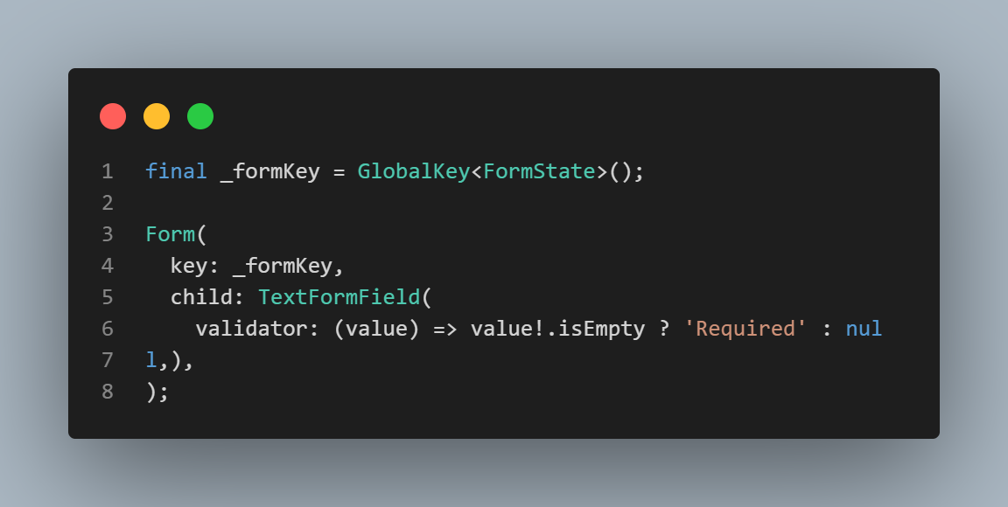
Form
Building forms for user input
Form: groups input fields.
TextFormField: supports built-in validation.
S25' Training Sessions

Slide 5
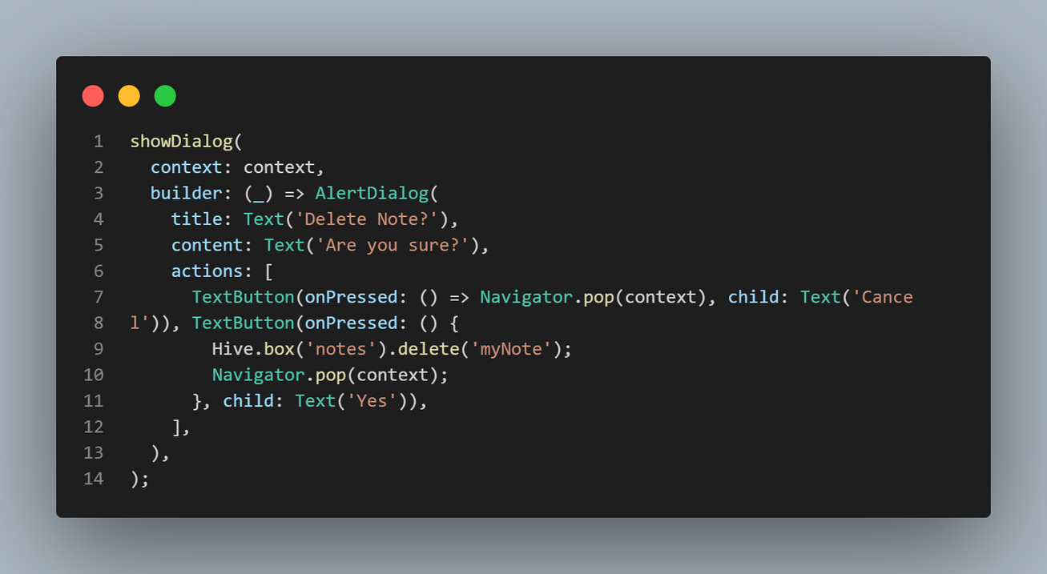
ShowDialog
Showing messages or confirmations
Used to ask for confirmation before actions (like delete or exit).
S25' Training Sessions

Slide 6
hive
What is Hive?
A lightweight & blazing fast NoSQL database.
Stores data locally on the user’s device.
Works offline.
Easy to integrate into Flutter apps.
S25' Training Sessions
NoSQL stands for "Not Only SQL".
It refers to non-relational databases that do not use traditional tables or schemas like SQL databases.

Slide 7
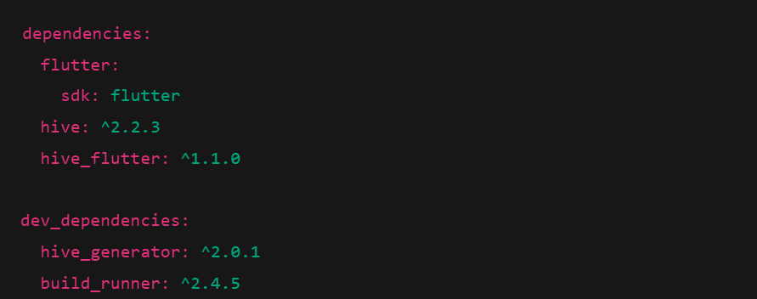
hive
Hive Step by Step
S25' Training Sessions
1-Add Hive Dependencies

Slide 8
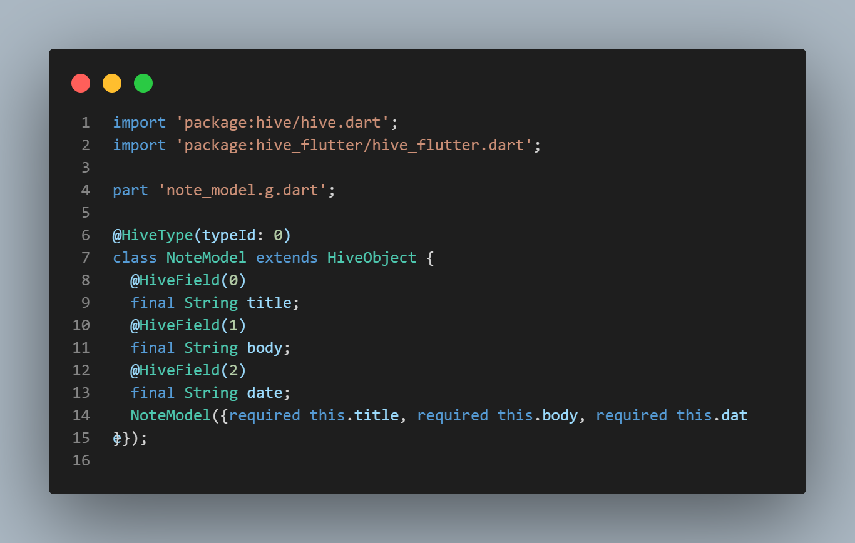
Hive
2 – Create a Model Class
S25' Training Sessions
Notes:
flutter packages pub run build_runner build

Slide 9
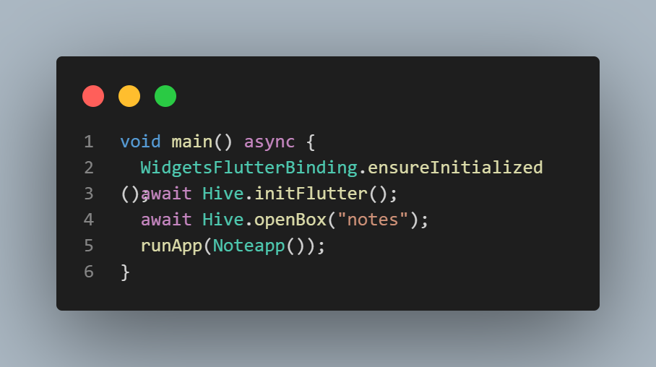
hive
3 – Initialize Hive
S25' Training Sessions
openBox must be done before accessing the box.

Slide 10
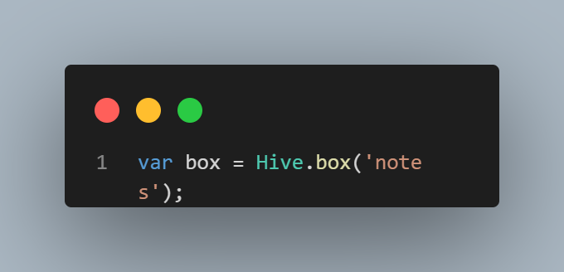
Hive
4 – Open a Box
S25' Training Sessions
A box is like a local table or file to store data.

Slide 11
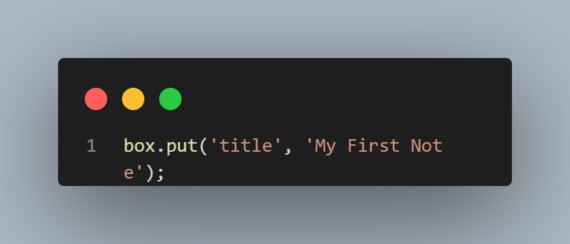
Hive
5– Save Data to Hive
S25' Training Sessions
put(key, value) : both key and value can be any type.

Slide 12
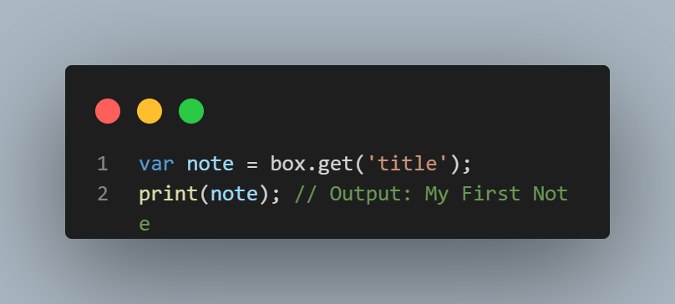
Hive
6 – Read Data from Hive
S25' Training Sessions
Returns null if the key doesn’t exist.

Slide 13
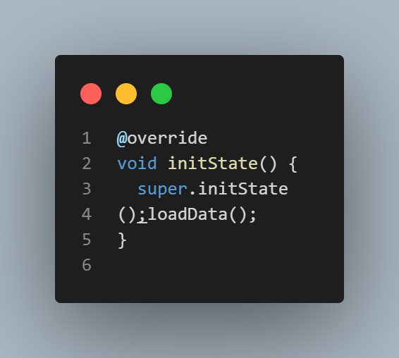
initstate
initState (Widget initialization)
Called before the widget builds.
Good place to load data from Hive.
S25' Training Sessions

Slide 14
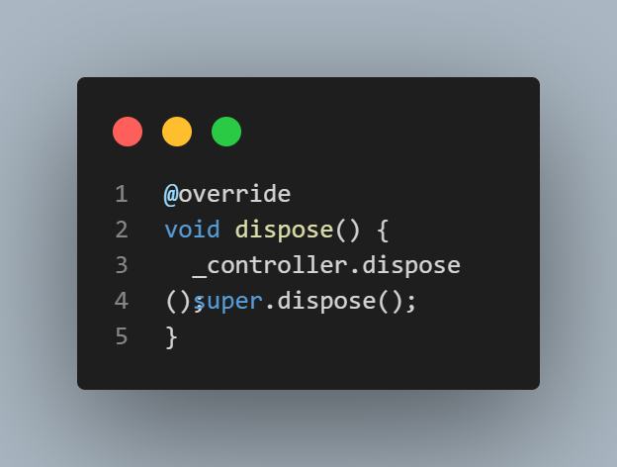
dispose
Clean up resources
Required when using controllers, focus nodes, or streams.
S25' Training Sessions
Prevents memory leaks.

Slide 15

tHANK YOU
SEE YOU NEXT TIME
S25' Training Sessions

